Slide 1
Point-In-Time Count: Volunteer Training

Slide 2
Agenda
PIT Overview
PIT Methodology
Unsheltered PIT Count
Sheltered PIT Count
Volunteer Prep
Counting Us App
Q&A

Slide 3
PIT Date
January 23rd, 2020

Slide 4
What is a Point-In-Time Count (PIT)?
A snapshot of how many homeless individuals are in your community on a single day.
On the local level, point-in-time counts help communities plan services and programs to appropriately address local needs, measure progress in decreasing homelessness, and identify strengths and gaps in a community’s current homelessness assistance system.

Slide 5
PIT Background – Why we count
FUNDING
Eligibility to apply for/ receive CoC funds from HUD
EXTENT
Trends of homelessness in the local area
AWARENESS
Raise community awareness
Characteristics of those experiencing homelessness
New programs
Raise political awareness

Slide 6
SUCCESSFUL PIT COUNT
Form PIT Committee
Inform Community
Recruit Volunteers
Know the Survey/app
Train Volunteers
Locations, Locations, Locations
Organize donations
Gather to Count!
Meet to Plan the Count
Select PIT Lead and Backup

Slide 7
WHO TO COUNT
Individuals & Families Living In:
Emergency Shelter
Transitional Housing
Domestic Violence Shelter
Hotel/Motel paid for by an organization
Places not meant for human habitation

Slide 8
WHO NOT TO COUNT
Individuals & Families Living In:
Doubled-up situations
Substandard housing
Permanent Supportive Housing program
Rapid Re-housing program
Hotel/Motel paid for with own funds
Locations using HUD-VASH vouchers
Shelters designed for foster care or DFPS children

Slide 9
Unsheltered PIT Count
The unsheltered PIT survey requires volunteers to identify homeless people that are living in places not meant for human habitation, such as:
On the street
In abandoned buildings
In their vehicles
In tents/shanties
Public parks
In the woods
Transportation stations

Slide 10
Unsheltered PIT – Survey Steps
There are five steps to completing an unsheltered PIT count survey. As an unsheltered volunteer you should:
Identify yourself, engage potential participants and explain the purpose of the count.
Deliver the script and the consent process. Obtain verbal consent to proceed.
Ask the screening questions. Determine if the individual is eligible.
Has anyone asked you questions about experiencing homelessness?
Where are you sleeping tonight?
If eligible, administer the survey questions, recording the participant’s responses. If ineligible, thank them for their time and move on.
Thank the respondent for their participation. If possible, provide the participant with donated items.

Slide 11
Unsheltered PIT – Sample Script
Hello, my name is ___________________, and I am helping ________________conduct a short survey of our community. We would like to learn more about people experiencing homelessness, what kinds of problems they face, and to see what services are needed to address homelessness.
Your participation is strictly voluntary, and all of your responses are confidential. Your privacy will be protected and respected. If questions make you uncomfortable you do not have to answer them. Would you be willing to take a few minutes to answer some questions?

Slide 12
Sheltered PIT Count
HUD defines sheltered homeless persons as adults, children, and unaccompanied youths who, on the night of the count, are living in shelters for the homeless.
Regardless of funding source, all providers of shelter, vouchers, or funds for shelters (including motel/hotel rooms), and/or transitional housing need to provide unduplicated information about the individuals and families on January 24th, 2019.
For Emergency Shelters, you should conduct the surveys in the late afternoon/evening when participants are checking in to stay the night.

Slide 13
Sheltered PIT – Who do you count?
You should count:
Emergency Shelters
Domestic violence shelters
Hotel, motel, or apartment vouchers paid for by a public or private agency because the individual or family is homeless
Transitional Housing
You should NOT count:
Persons living doubled up in conventional housing;
Formerly homeless persons living in Section 8 SRO, Shelter Plus Care, Supportive Housing Program permanent housing or other permanent housing units;
Persons living in conventional housing and receiving temporary assistance (Rapid Rehousing or Homelessness Prevention) from a program funded by the Homelessness Prevention and Rapid Re-housing Program (HPRP);
Children or youth, who because of their own or a parent’s homelessness or abandonment now reside temporarily or for a short anticipated duration in hospitals, residential treatment facilities, emergency foster care, or detention facilities;
Adults in mental health facilities, chemical dependency facilities, or criminal justice facilities.

Slide 14
Unsheltered And Sheltered Counts
Do’s
Don’ts
If you have obtained consent
Do not complete a survey without consent
Do not continue the survey if the individual has expressed the desire to end the survey
Do not complete a survey based on an intake form unless you have specifically obtained consent to do so.

Slide 15
Observation PIT Count
This survey requires NO direct interaction and is used mostly as a head count
Reasons why you would conduct an Observation survey:
The individual is sleeping
Refused to take the survey
If you do not feel comfortable approaching the participant

Slide 16
Observation Survey
Do’s
Don’ts
Someone is sleeping
You do not feel comfortable going to a certain area
A person did not give their consent to participate in the survey or they don’t want to complete the survey in it’s entirety
Someone does not seem to understand the consent process and cannot reasonably consent to the survey.
Do not fill out an observation survey if you have not laid eyes on the individual that day

Slide 17
PIT Volunteer Prep and Forms
Download and register an account with the Counting Us App
Practice entering surveys using code: TX2020
Don’t be afraid to make mistakes, this is all test data!
Review the survey and become comfortable with the questions
Talk to your PIT lead about any concerns prior or on the day of the count

Slide 18
Safety
Do
Don’t
Always work in teams
Be respectful of space
Ask a person to participate if you think they are homeless
Introduce yourself and explain what you are doing
Be sincere and caring
Know how to de-escalate
Know emergency numbers
Honor requests to not participate
Provide shelter information if possible
Dress appropriately
Leave valuables behind
Wake up someone
Approach if you don’t feel comfortable
Mandate participation
Invade personal space
Promise anything you can’t deliver
Be judgmental
Give money or offer rides
Share any confidential info or photos of participants
Panic
Put anyone in danger
Deviate from the survey

Slide 19
Best Practices
Familiarize yourself with the survey
Communicate your intentions to prospective survey participants
Obtain consent to administer the survey
Express confidence and compassion
When surveying individuals in a group, prioritize safety and protect participant’s information
Come up with a safety phrase for discomfort amongst your team
Know volunteer expectations
Know community resources
Contact PIT Lead if any issues arise

Slide 20
Checklist
Items to bring with you:
Comfortable clothes and shoes
Fully charged cell phone (portable charger if possible)
Flashlight (if conducting count at night or early morning)
Pen and notepad
Vehicle if necessary
“Goodie bags” to pass out if provided

Slide 21
Volunteer Hour Tracker
ALL VOLUNTEERS MUST FILL OUT ONLINE FORM!
*Please have volunteers fill out on the day of the count after completing their shift*

Slide 22
Counting Us App

Slide 23
What you need– Prep and Forms
Download and register an account with the Counting Us App
Practice entering surveys using code: TX2020
Don’t be afraid to make mistakes, it is all test data before 1/23/20!
Make sure you have a full battery!
Review the survey and become comfortable with asking the questions
Volunteer Interviewing Guide
Talk to your PIT lead about any concerns prior or on the day of the count
It is important, especially on the day of the count, to inform your PIT lead of any issues immediately

Slide 24
Day of Count Set-Up Key
MAKE SURE ON THE DAY OF THE COUNT ALL SURVEYS ARE COLLECTED UNDER SET-UP KEY…
TX2020

Slide 25
Counting Us Training Materials
Click here for a short tutorial on Registering for the Count
Click here for a short tutorial on Sheltered Count
Click here for a short tutorial on Unsheltered Count
Click here for a short tutorial on Observation Count
*Links to these videos are also on our website thn.org

Slide 26
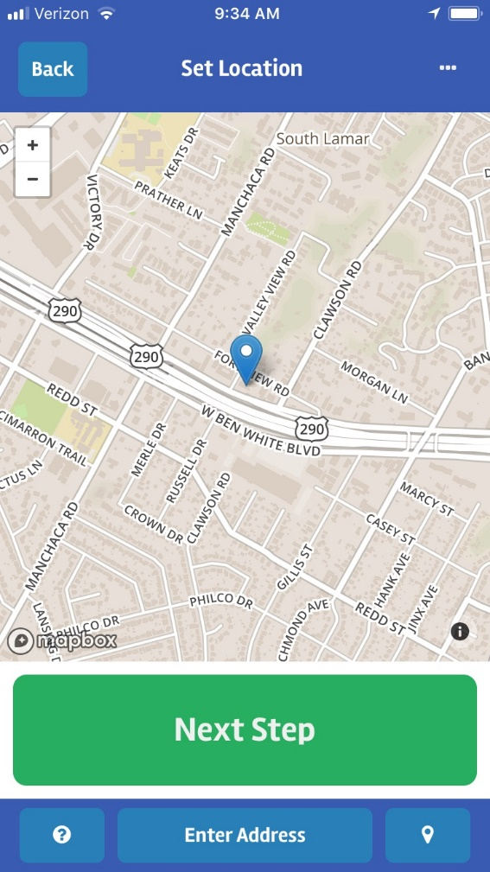
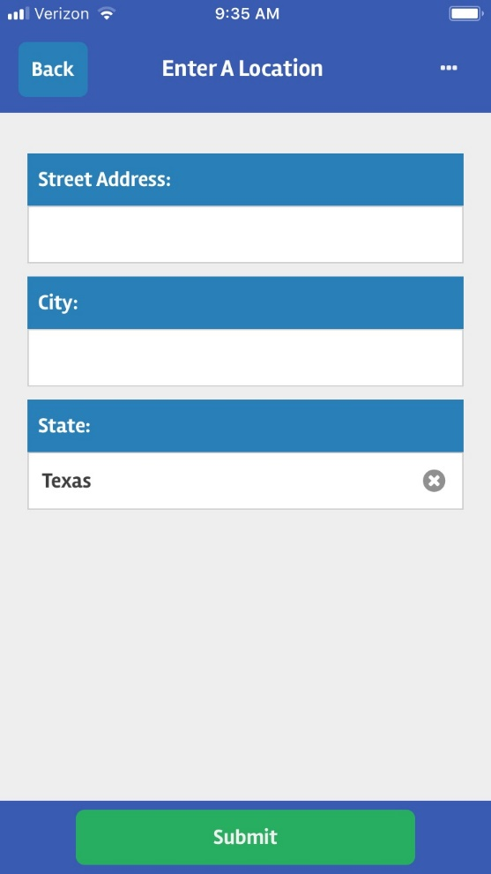
DV Survivors and Surveys
Use Counting Us App
On geo-location screen, click “Enter Address” button and ONLY enter in City and State information
DO NOT enter in first or last name
For date of birth information ONLY enter in age range

Slide 27
Register for the Count
Click here
Go online to THN’s website
Texas Balance of State→Data→Point-in-Time Reports→Winter Training Materials→Volunteer Materials→Volunteer Registration Portal
Complete registration ASAP!

Slide 28
Next Steps!
Register for the Count
Complete the PIT Quiz on Google Forms (link on next slide)
Work with your PIT Lead to develop a strategy and game plan for where you will count on 1/23/20.
Check out the Volunteer Materials on THN’s website

Slide 29
DON’T FORGET!
Please submit the Volunteer Hour Tracker form online by 1/30/20

Slide 31
Quiz time!
Please click here to start the process
Steps to complete:
Complete the quiz (need 70% or higher to pass)
If you do not pass the first time, no worries, please take it over
SUBMIT!

Slide 32
THANK YOU!!!

